Slide 1
computer
1What is the computer?
a computer is an electronic device that can accept,process,store,and output information.this informationcan be anything from text and numbers to images and videos.

Slide 2
hardware
hardware:the physical components
Central processing unit(cpu)
The brain of the computer,responsible for performing calculation and instruction.
Memory(ram)
Temporaty storage for data the CPU isactively using,allowing for fast access.
Storage
Permanent storage for data,such as hard drives,solid-state drives,and flash drive.

Slide 3
software
The instructions and programs
1 operating system(os)
The foundation of a computer,managing resources and providing a user
Interface.
2 applications
Programs designed to perfom specific tasks, like word processing,web browsing,or gaming.
3 drivers
Softmunware thatenable the OS to communicate with hardware components.

Slide 4
Input device
Keyboard
Computer mouse
Scanners
Cameras
Joysticks
microphones
Output device
Monito/display
Printer
speaker
headphone
projectors
plotter
Braille display,haptic,feedback device,digital signage display,touchscreent,ets.
spp

Slide 5
Types of computer
Micro computer
Mini computer
Main frame computer
Super computer
Key board
Used to enter text.numbers and commands
mouse
Used to control the cursor on the screen,interact with object, and navigate menus.
touchscreen
Allows for direct interaction with the computer using touch gestures.

Slide 6
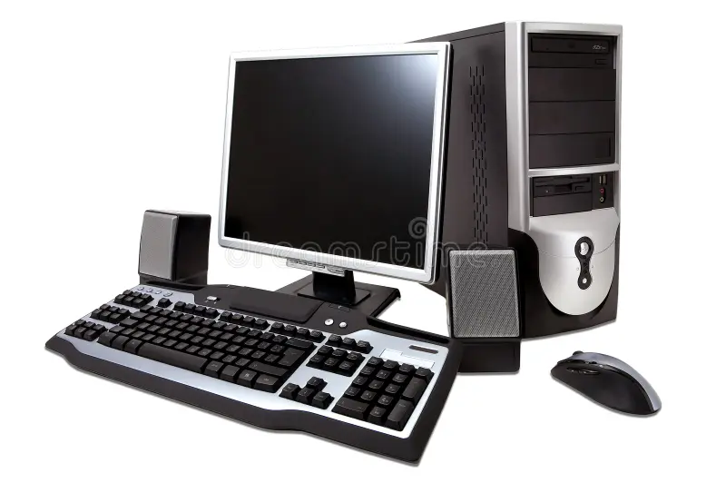
Computer
Whate is computer?
A computer is an electronic device is which is using calculation and analys
Data or information.
Input - process - out put

Slide 7
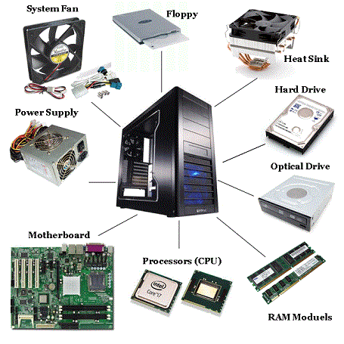
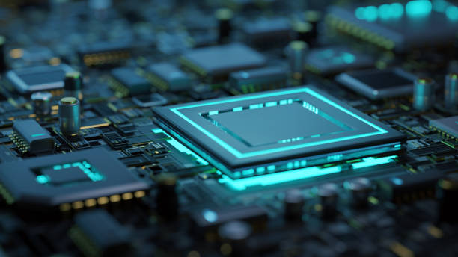
Understanding hardware;the physical components
central processing unit(cpu)
Memory(ram)
Temporary storage for data the cpu is actively using, allowing for fast acces.
Storage devices
Permanent storage for data ,such as hard
Drives, solid-state drives,and flash drives.

Slide 8
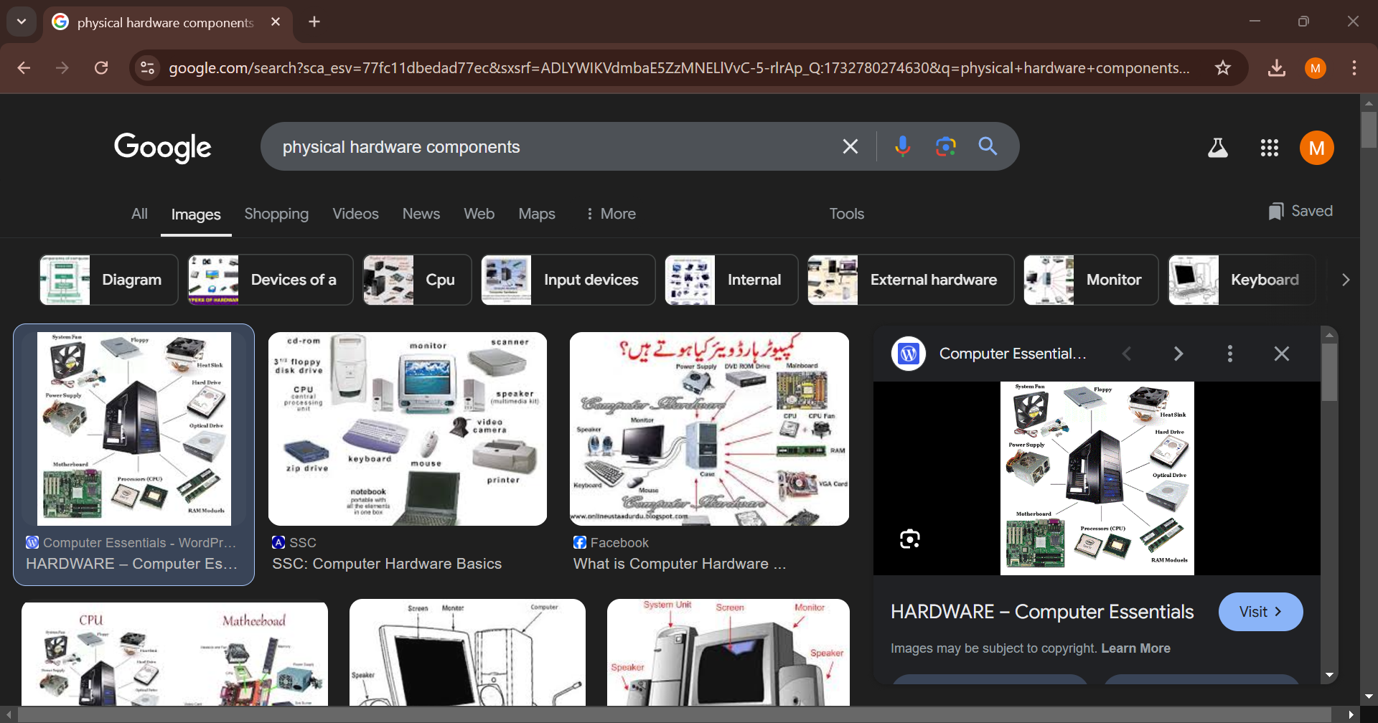
Soft ware compones

